Slide 1
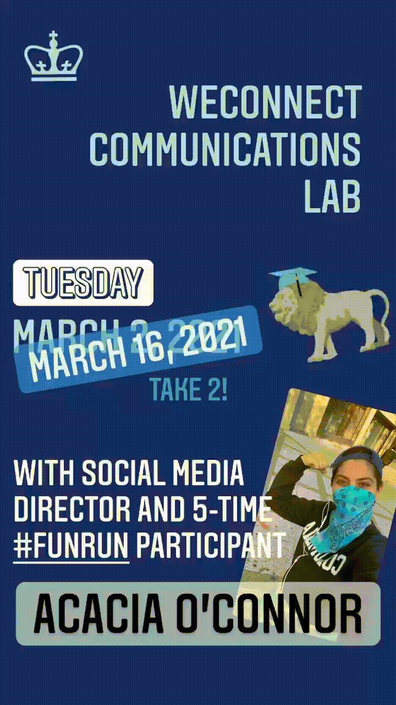
WeConnect Virtual Communications Lab
Social Media
@socialatcolumbia
Acacia O’Connor (they/them)
🦁 📲 Director, Columbia Social
Notes:
-Setting Your Intentions
-Building the Structure of Success
-Time Management (when your eyes are too big for your platform / hacking content creation)
-Relationship Management
-Vibing / All of the Feels
-Progress Reports and After-Action Reports

Slide 2
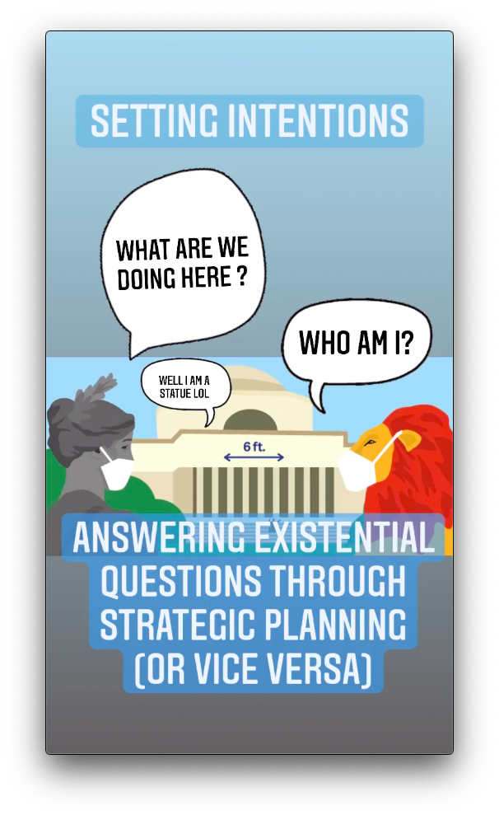
Follow along on Instagram Stories instead
Follow @socialatcolumbia

Slide 3
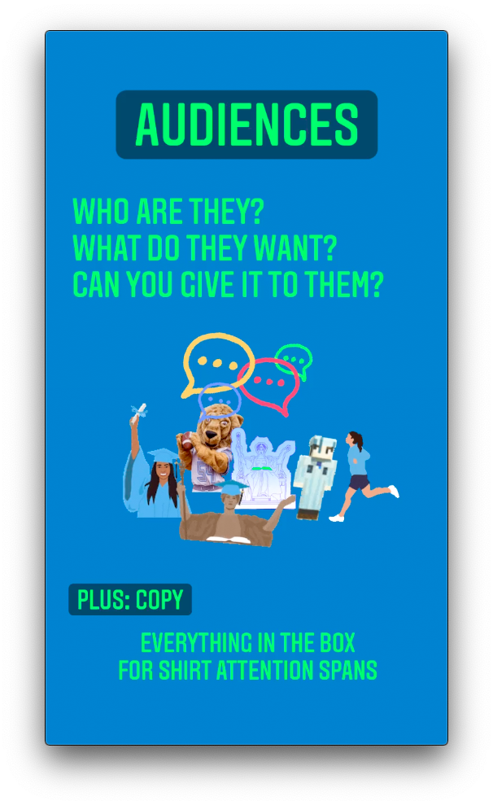
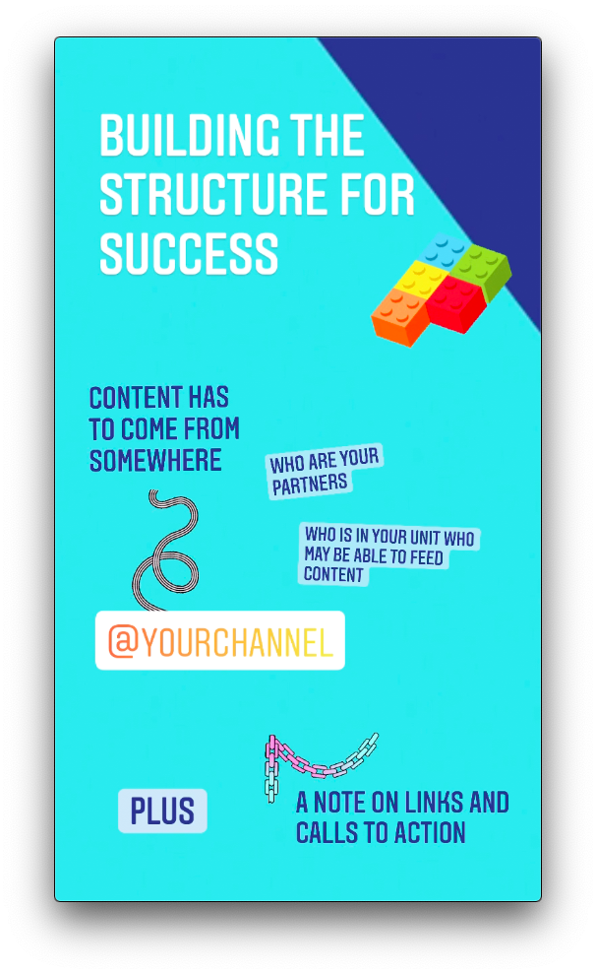

Slide 4
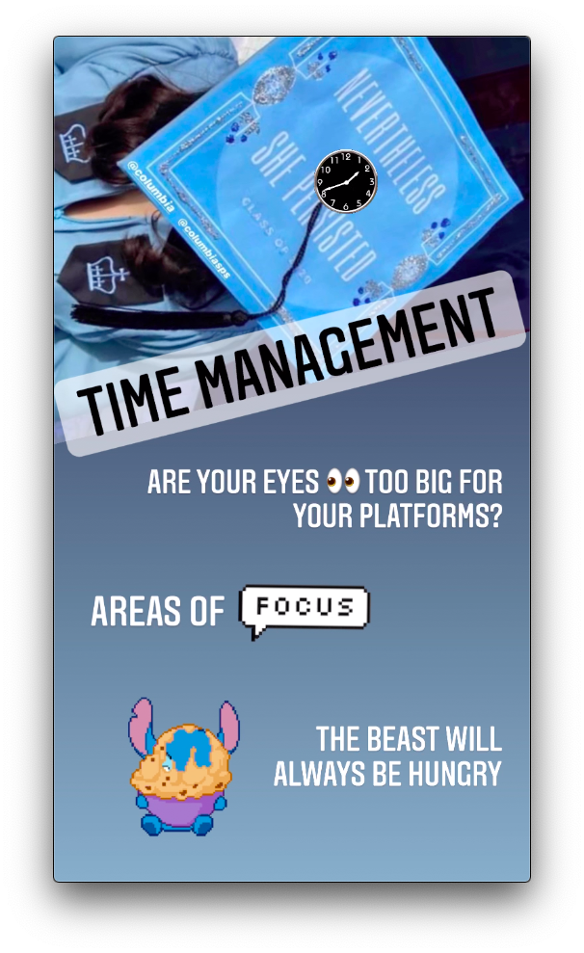
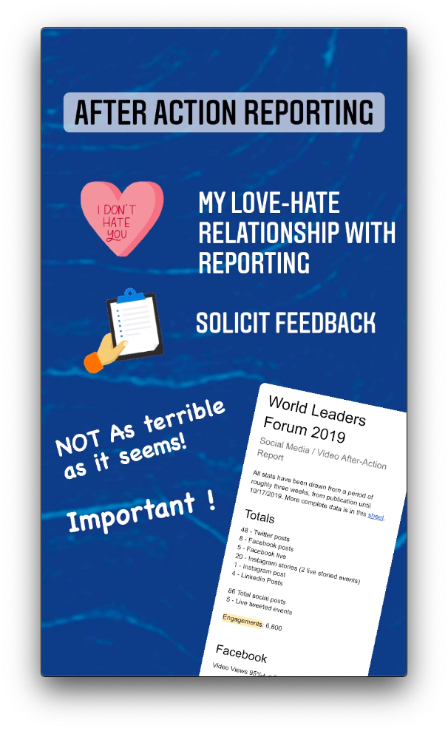

Slide 5
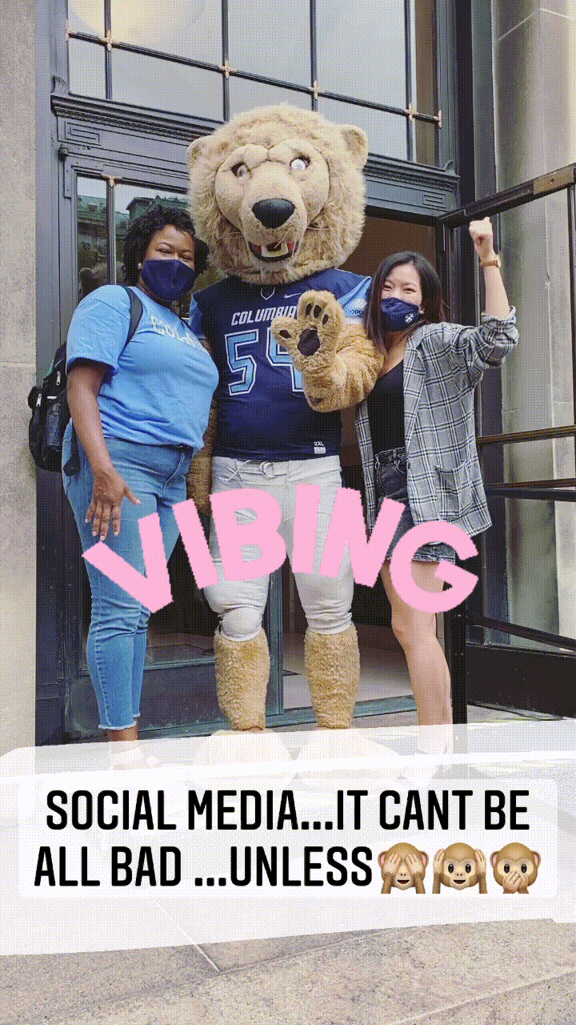
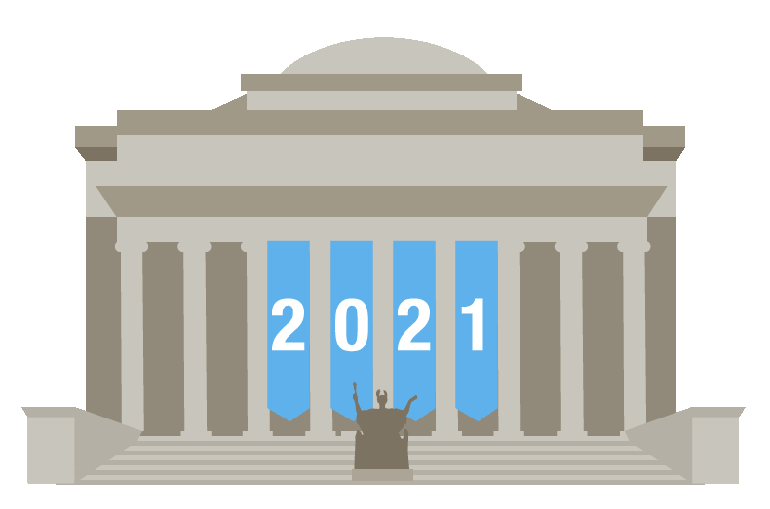
Follow up with Acacia
acaciaoconnor@columbia.edu
amo2154

